Slide 1
JavaScript
Lecture 5

Slide 2



So What is a Web Page Really?
CONTENT
STRUCTURE
STYLE
BEHAVIOR

Slide 3
Why do we talk about these things separately?
Separation of Concerns
This is a concept from Software Engineering that every part of a program should address a separate "concern".
In web programming, we define those concerns as:
Content (words, images)
Structure/Meaning (HTML)
Style/Appearance (CSS)
Behavior
What happens if we don't separate them?
https://repl.it/@afitzg/UnseparateConcerns#index.html

Slide 4
What we’ve learned so far
How to write content for a webpage using HTML5
How to add styles to a webpage using CSS and linking a CSS file to an HTML file

Slide 5
CSC 196W Modules
Web page structure and appearance with HTML5 and CSS.
Client-side interactivity with JS DOM and events.
Using web services (API's) as a client with JS.
Writing JSON-based web services with a server-side language.
Storing and retrieving information in a database with SQL and server-side programs.

Slide 6
JavaScript is to Java as ...
Grapefruit → Grape
Carpet → Car
Hamster → Ham
Catfish → Cat
Horse → Horseradish

Slide 7
What is JavaScript?
A lightweight "scripting" programming language
Created in 1995 by Brendan Eich (original prototype created in 10 days and called LiveScript)
NOT related to Java other than name and some syntactic similarities...
Used to define interactivity for web pages.

Slide 8
Why JavaScript and not another language?
Popularity.
The early web browsers supported it as a lightweight and flexible way to add interactivity to pages.
Microsoft created their own version, called JScript, but the open source browsers (notably Firefox and Chrome) put all their effort into JavaScript.
Now: If you want to run anything other than JavaScript in the browser… it's Very Hard™ (often impossible)

Slide 9
Web page Behavior with JavaScript
Now that we know how to add content and styles to a web page, let's explore how to add responsive behavior
We'll use these building blocks to dynamically update what you see on a web page in response to clicks, text input, timers, etc.

Slide 10
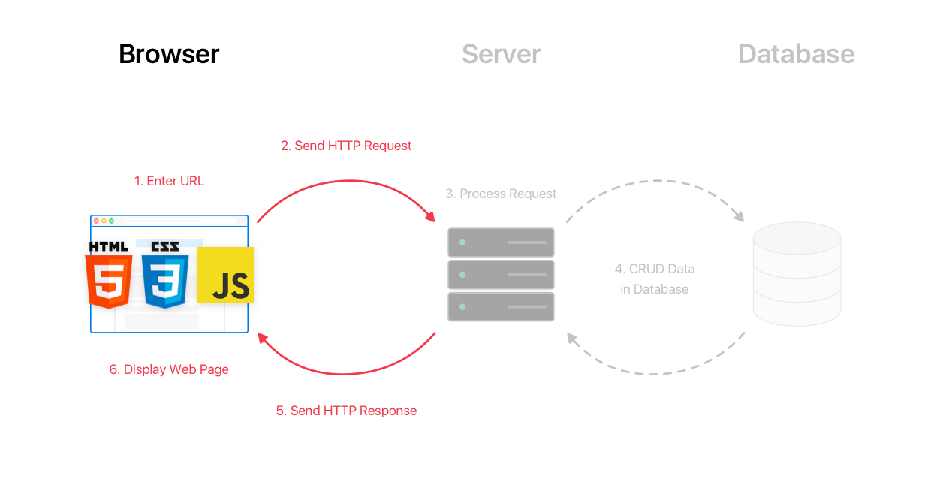
Terminology: Client-Side Scripting
Client-side script: Code that runs on the user's computer and does not need a server to run (just a browser!).
Client-side JavaScript is usually run after HTML and CSS have been loaded on the browser (e.g. from a server response).
Often, this JavaScript manipulates the page or responds to user actions through "event handlers".

Slide 11
JS: Adding Behavior to HTML/CSS
We can use write JavaScript functions to...
Insert dynamic text into HTML (ex: username)
React to events (ex: page load, user's mouse click)
Get information about a user's computer (ex: what browser they are using)

Slide 12
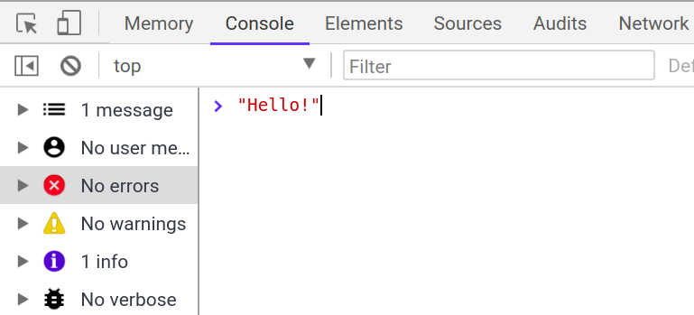
Today: Following Along
As an interpreted programming language, JS is great to interact with a line at a time (similar to Python, but very different than Java). Where do you start?
The easiest way to dive in is with the Chrome browser's Console tab in the same inspector tool you've used to inspect your HTML/CSS.
Until we learn how to interact with the HTML DOM with JS, we recommend experimenting with the following code examples using this console to get comfortable with the basic syntax and behavior.

Slide 13
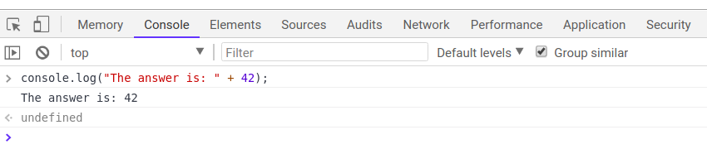
Our First JavaScript Statement: console.log
Used to output values to the browser console, most often used to debug JS programs. You can think of this as System.out.println in Java or print in Python.
console.log(“message”);
console.log(“The answer is: ” + 42);

Slide 14
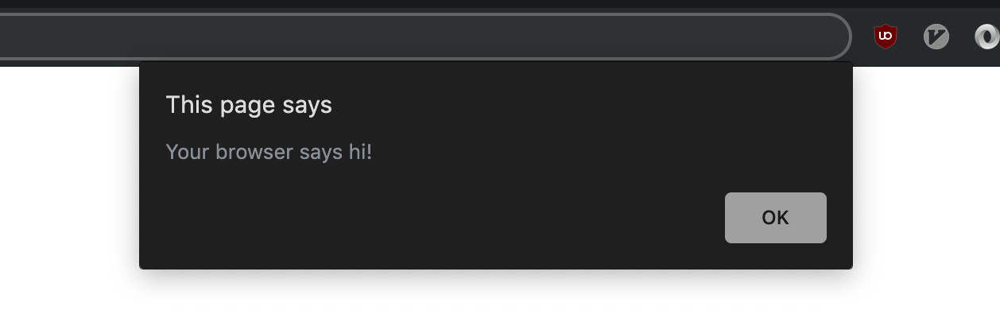
The alert function
A JS function that pops up a dialog box with a message - not ideal in practice, but sometimes a recommended debugging tool when first learning JS. Don't include alert statements in any of your assignments.
alert(“message”);
alert("Your browser says hi!");

Slide 15
Comments (similar to Java)
// single-line comment
/**
* multi-line
* comment
*/
Identical to Java's comment syntax
Recall: 3 comment syntaxes
HTML: <!-- comment -->
CSS/Java/JS: /* comment */
Java/JS: // comment

Slide 16
Variables
// template
let name = expression;
// examples
let level = 23;
let accuracyRate = 0.99;
let name = "Pikachu";
Variables are declared with the let keyword (case-sensitive). You may also see var used instead of let - this is an older convention with weaker scope - DO NOT USE var anywhere
Question: What does weaker scope mean? Why is this a "bad" thing?
CQG: Use camelCasing for variable (and function) names

Slide 17
“Types” in JavaScript
let level = 23; // Number
let accuracyRate = 0.99; // Number
let name = "Pikachu"; // String
let temps = [55, 60, 57.5]; // Array
Types are not specified, but JS does have types ("loosely-typed")
Number, Boolean, String, Array, Object, Function, Null, Undefined
Can find out a variable's type by calling typeof, but usually this is poor practice (why?)
Note: Type conversion isn't always what you expect...

Slide 18
A Note about Declaring Types in JavaScript
If you've programmed in a statically-typed language like Java, you will recall that when declaring variables, you must specify their type which must always stay the same.
boolean isValid = "hello!"; // error
In a dynamically-typed language like JavaScript, you don't need to specify the type (just use let or const) and you may change the type the variable refers to later in execution.
let isValid = true; // no error
isValid = "hello!";
isValid = 1;
In a dynamically-typed language like JavaScript, you don't need to specify the type (just use let or const) and you may change the type the variable refers to later in execution.

Slide 19
Number Type
let enrollment = 99;
let medianGrade = 2.8;
let credits = 5 + 4 + (2 * 3);
Integers and real numbers are the same type (no int vs. double). All numbers in JS are floating point numbers.
Same operators: + - * / % ++ -- = += -= *= /= %= and similar precedence to Java.
Many operators auto-convert types: "2" * 3 is 6
NaN ("Not a Number") is a return value from operations that have an undefined numerical result (e.g. dividing a String by a Number).
Practice!

Slide 20
String type
let nickName = "Sparky O'Sparkz"; // "Sparky O'Sparks"
let fName = nickName.substring(0, s.indexOf(" ")); // "Sparky"
let len = nickName.length; // 15
let name = 'Pikachu'; // can use "" or ''
Methods: charAt, charCodeAt, fromCharCode, indexOf, lastIndexOf, replace, split, substring, toLowerCase, toUpperCase

Slide 21
More about Strings
Escape sequences behave as in Java: \' \" \& \n \t \\
To convert between Numbers and Strings:
let count = 10; // 10
let stringedCount = "" + count; // "10"
let puppyCount = count + " puppies, yay!"; // "10 puppies, yay!"
let magicNum = parseInt("42 is the answer"); // 42
let mystery = parseFloat("Am I a number?"); // NaN
To access characters of a String s, use s[index] or s.charAt(index):
let firstLetter = puppyCount[0]; // "1"
let fourthLetter = puppyCount.charAt(3); // "p"
let lastLetter = puppyCount.charAt(puppyCount.length - 1); // "!"

Slide 22
Common Bugs when Using Strings
While Strings in JS are fairly similar to those you'd use in Java, there are a few special cases that you should be aware of.
Remember that length is a property (not a method, as it is in Java)
Concatenation with +: 1 + 1 is 2, but "1" + 1 and 1 + "1" are both "11"!
Practice: repeat

Slide 23
Special Values: null and undefined.
let foo = null;
let bar = 9;
let baz;
/* At this point in the code,
* foo is null
* bar is 9
* baz is undefined
*/
undefined: declared but has not yet been assigned a value
null: exists, but was specifically assigned an empty value or null. Expresses intentional a lack of identification.
A good motivating overview of null vs. undefined
Note: This takes some time to get used to, and remember this slide if you get confused later.

Slide 24
Arrays
let name = []; // empty array
let names = [value, value, ..., value]; // pre-filled
names[index] = value; // store element
let types = ["Electric", "Water", "Fire"];
let pokemon = []; // []
pokemon[0] = "Pikachu"; // ["Pikachu"]
pokemon[1] = "Squirtle"; // ["Pikachu", "Sqiurtle"]
pokemon[3] = "Magikarp"; // ["Pikachu", "Sqiurtle", undefined, "Magikarp"]
pokemon[3] = "Gyarados"; // ["Pikachu", "Sqiurtle", undefined, "Gyarados"]
Two ways to initialize an array
length property (grows as needed when elements are added)

Slide 25
Some Notes on Typing
As you write JS programs, you may run into some silent bugs resulting from odd typing behavior in JS. Automatic type conversion, or coercion, is a common, often perplexing, source of JS bugs (even for experienced JS programmers).
Why is this important to be aware of? You'll be writing programs which use variables and conditional logic. Knowing what is considered truthy/false and how types are evaluated (at a high level) can make you a much happier JS developer (some practice)
Examples of some "not-so-obvious" evaluations:
2 < 1 < 2;// true
0 + "1" + 2;// "012"
[] + [];// ""
"1" / null;// Infinity
[+!![]]+[[![]+!![]]];// "11"
This is worth 3 minutes of your viewing pleasure. (starting at 1:20)

Slide 26
Defining Functions
// template
function name(params) {
statement;
statement;
...
statement;
}
// example
function myFunction() {
console.log("Hello!");
alert("Your browser says hi!");
}
The above could be the contents of basics.js linked to our HTML page
Statements placed into functions can be evaluated in response to user events

Slide 27
JS Function vs. Java Method
function repeat(str, n) {
let result = str;
for (let i = 1; i < n; i++) {
result += str;
}
return result;
}
let repeatedStr = repeat("echo...", 3); // "echo...echo...echo..."
}
public static String repeat(String str, int n) {
String result = str;
for (int i = 1; i < n; i++) {
result += str;
}
return result;
}
String repeatedStr = repeat("echo...", 3); // "echo...echo...echo..."
}

Slide 28
JS Function vs. Python Function
function repeat(str, n) {
let result = str;
for (let i = 1; i < n; i++) {
result += str;
}
return result;
}
let repeatedStr = repeat("echo...", 3); // "echo...echo...echo..."
}
def repeat(str, n):
result = str;
for i in range(1, n):
result = result + str;
return result;
repeatedStr = repeat("echo...", 3) // "echo...echo...echo..."

